Slide 1


Bullying Risk Prediction Application
Daniel Meier

Slide 2
Application Purpose
This application takes in various factors that are believed to impact bullying to assess whether someone is at risk for bullying or not.
Features included the following:
Cyberbullying
Physically Attacked
Close Friends
Understanding Parents
Age
Gender
Frequency of feeling lonely
Frequency of missing school without permission
Perception on whether other students are kind and helpful

Slide 3
Model Used
Logistic Regression and Random Forest Classifier were tested
The best performing model:
Random Forest Classifier tuned with GridSearchCV utilizing an under sampled minority target class (“No” target greatly outnumbered the “Yes” class)
Needed to bring the target classes into balance to help the model learn better

Slide 4
Project Methodology
Data Wrangling/Cleaning
Dropped duplicated data
Removed columns without significant missing data
Feature Engineering
Encoding of features
Grouping of features (created AgeGroup, for example)
Model Runs – Six iterations per model type

Slide 5
Project Methodology cont.
Iterations included the following:
All Features, Base Parameters
All Features, Tuned Model, Base Parameters
Dropped two lowest scoring features based on feature importance, base parameters
Dropped two lowest scoring features based on feature importance, tuned model
Under sampled minority class, base parameters, all features
Under sampled minority class, tuned model, all features (best performer)

Slide 6
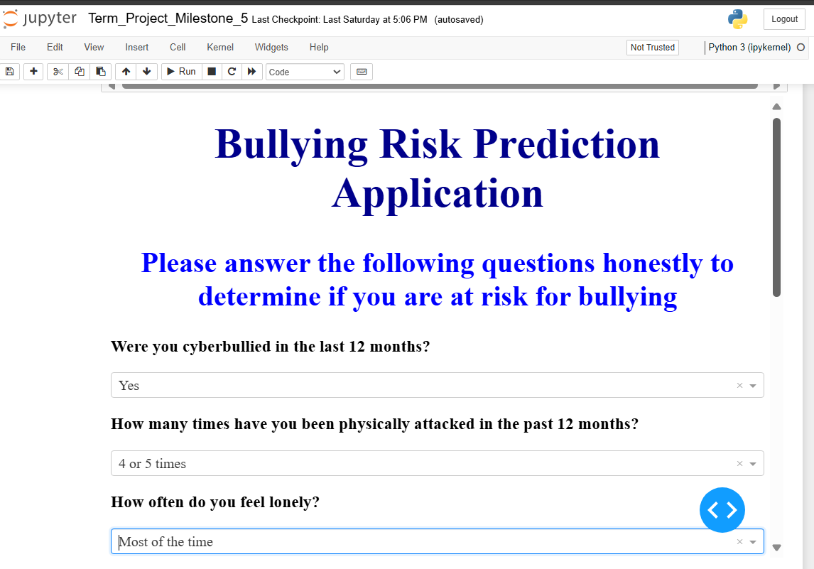
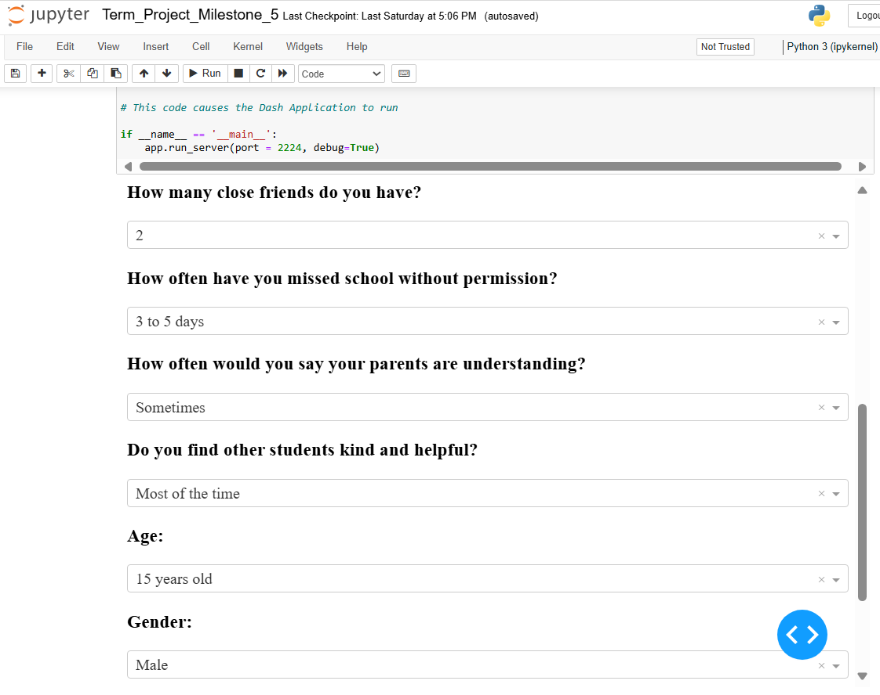
Application in Action

Slide 7
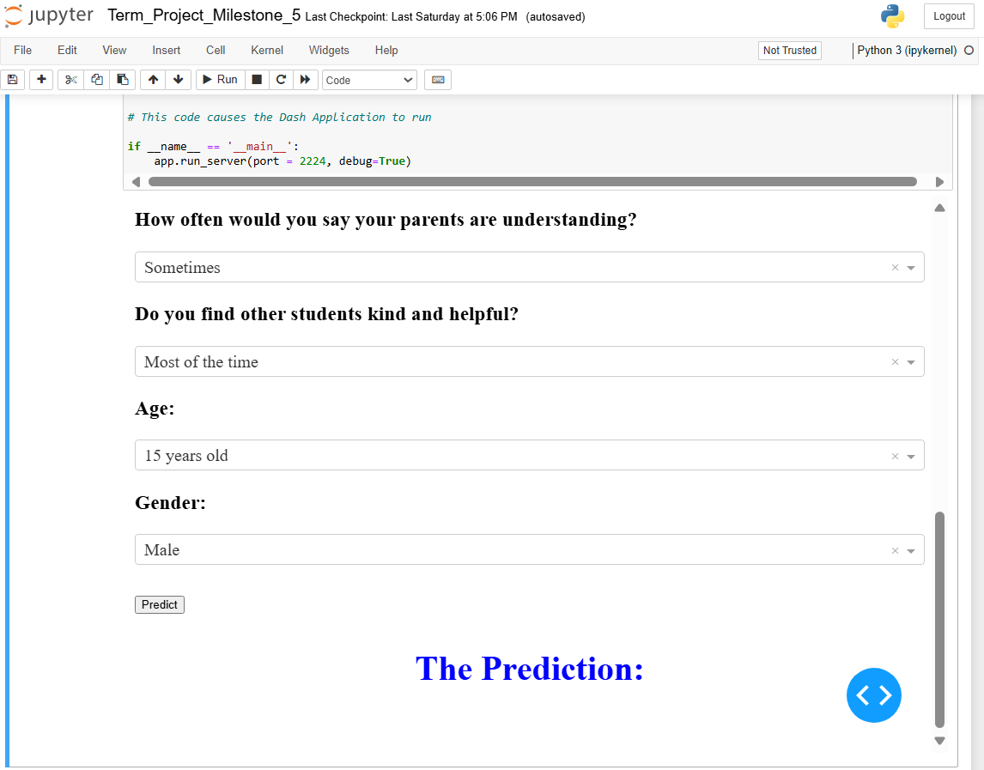
Application in Action cont.

Slide 8
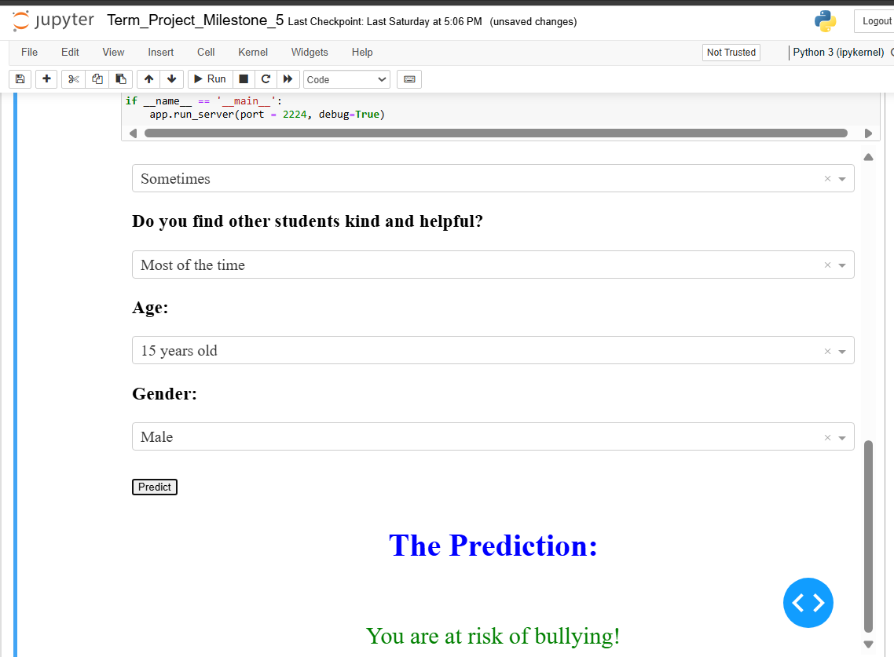
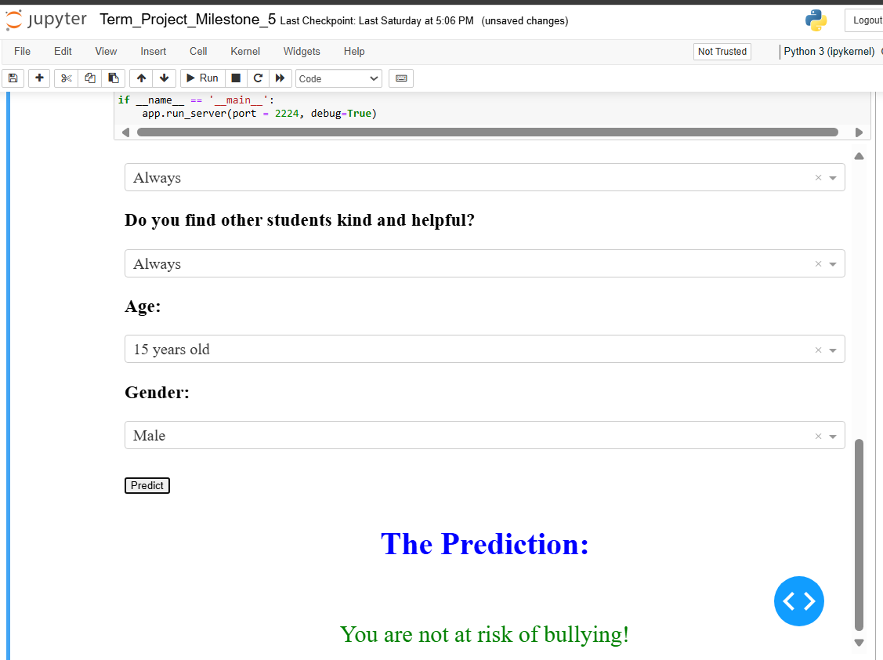
Application in Action cont.
This demonstrates both results that can be returned from the inputs.

Slide 9
Next Steps:
Ideally, acquire more data, specifically around the minority class (Yes)
Add additional questions to the data to incorporate more features
Change the approach regarding asking questions surrounding weight (feature was dropped due to missing over 2/3 of this data).
Use the results to incorporate targeted programs to address the factors that are leading to bullying

Slide 10
References:
Arya, N. (2022, July 25). KDnuggets. Does the Random Forest Algorithm need Normalization? https://www.kdnuggets.com/2022/07/random-forest-algorithm-need-normalization.html
Brownlee, J. (2020, August 27). Machine Learning Mastery. 3 Ways to Encode Categorical Variables for Deep Learning. https://machinelearningmastery.com/how-to-prepare-categorical-data-for-deep-learning-in-python/
Brownlee, J. (2020, August 31). Machine Learning Mastery. Metrics to Evaluate Machine Learning Algorithms in Python. https://machinelearningmastery.com/metrics-evaluate-machine-learning-algorithms-python/
Brownlee, J. (2021, January 27). Machine Learning Mastery. Undersampling Algorithms for Imbalanced Classification. https://machinelearningmastery.com/undersampling-algorithms-for-imbalanced-classification/
(2024). Plotly. Dash Layout. https://dash.plotly.com/layout
Koehrsen, W. (2018, January 9). Towards Data Science. Hyperparameter Tuning the Random Forest Forest in Python. https://towardsdatascience.com/hyperparameter-tuning-the-random-forest-in-python-using-scikit-learn- 28d2aa77dd74

